Slide 1

MERN Project

Slide 2
Objectives
01
Project description
Understanding the project requirement and how to approach the problem.

Slide 3

Project Description

Slide 4

Online Library Management System
Problem statement
Create an online Library application through which a user can rent books for a specific duration. The user of this application will be able to search books based on certain criteria such as author, category etc. The application will have 3 types of users,
User
Staff
Admin

Slide 5
Online Library Management System
Problem statement
The application should have the following features:
User can rent books for specific duration.
If the user does not return book in the specified time duration, late fees will be charged.
Staff members can upload book details on the application.
Staff members can approve or deny rent requests made by the users.
Admin can add/remove staff members.
Admin can ban users from the application.

Slide 6
Online Library Management System
Problem statement
Tasks: -
Task 1: - Implement Login Signup functionality for 3 different types of user accounts: user, staff, and admin
Task 2: - Implement Dashboard for different types of users. Dashboard should provide Interface to perform different functionalities relevant to the users.
Task 3: - Add search functionality to the application from which users will be able to search available books using different filters.
Task 4: - Implement transactions system in the application using which users can make payments.

Slide 7
Online Library Management System
Problem statement
Tasks: -
Task 5: - Implement approval system though which staff/admin can approve requests made by users.
Task 6: - Implement Authentication and authorization system in the application.

Slide 8
Online Library Management System
Problem statement
Outcomes:
Learners will be able to create a MERN project from scratch
Learners will be able to design and implement algorithms acquired through study of data structures and algorithms.
Learners will be able to design and develop User Interface using different technologies such as HTML, CSS, bootstrap, JS, and React
Learners will be able to develop a backend API using Node and Express.

Slide 9
Online Library Management System
Problem statement
Outcomes:
Learners will be able to design and develop database schema using mongo DB database
Learners will be able to use version control system (git and GitHub) to collaborate with other team members while working on a project
Learners will be able to create system design documents, database schema used in software development process.
Learners will be able to implement authentication and authorization in the project.

Slide 10
Online Library Management System
Problem statement
Technology used:
Front End:
HTML
CSS
JS
React

Slide 11
Online Library Management System
Problem statement
Technology used:
Back End:
Node
Express
Mongoose
Database:
MongoDB

Slide 12
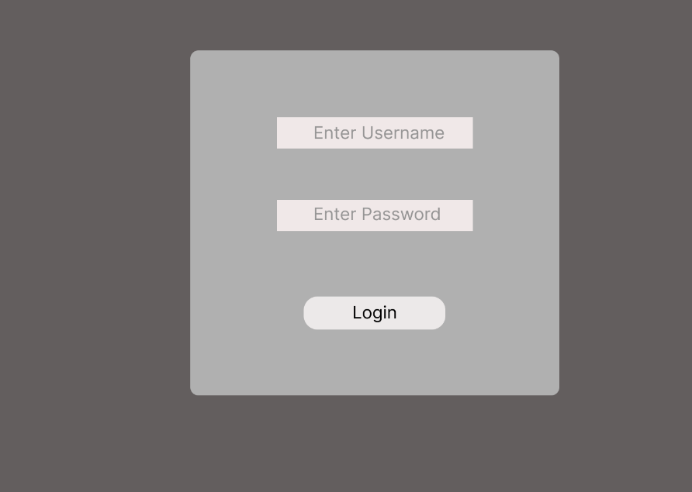
Online Library Management System
Suggest Layout Design
Login Page

Slide 13
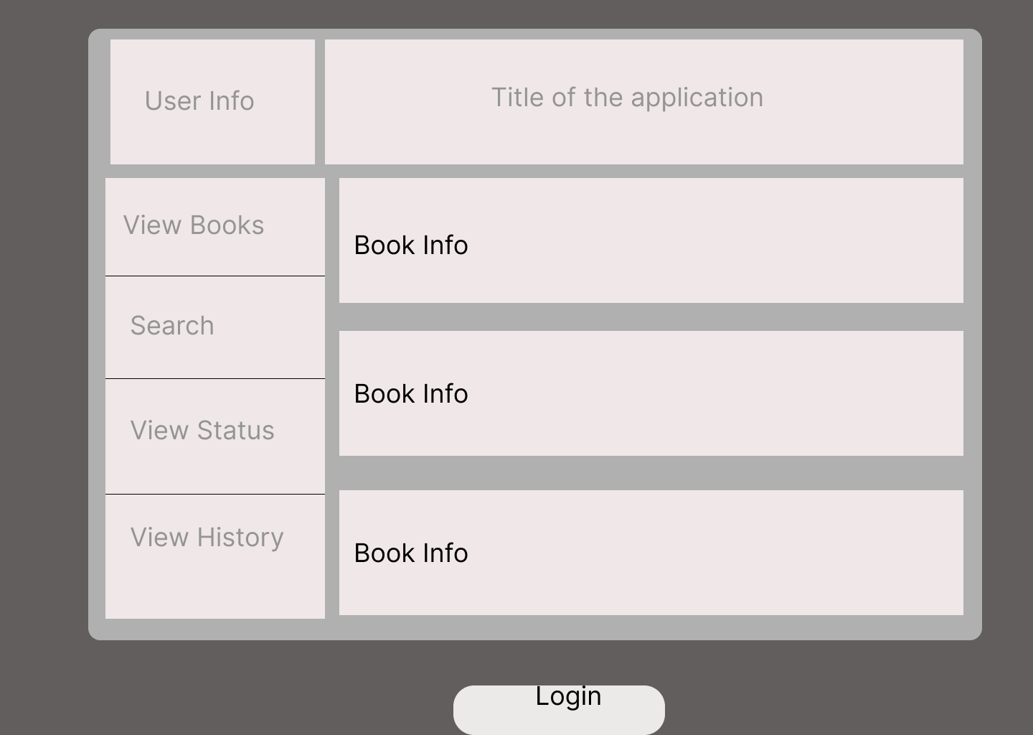
Online Library Management System
Suggest Layout Design
User Dashboard

Slide 14
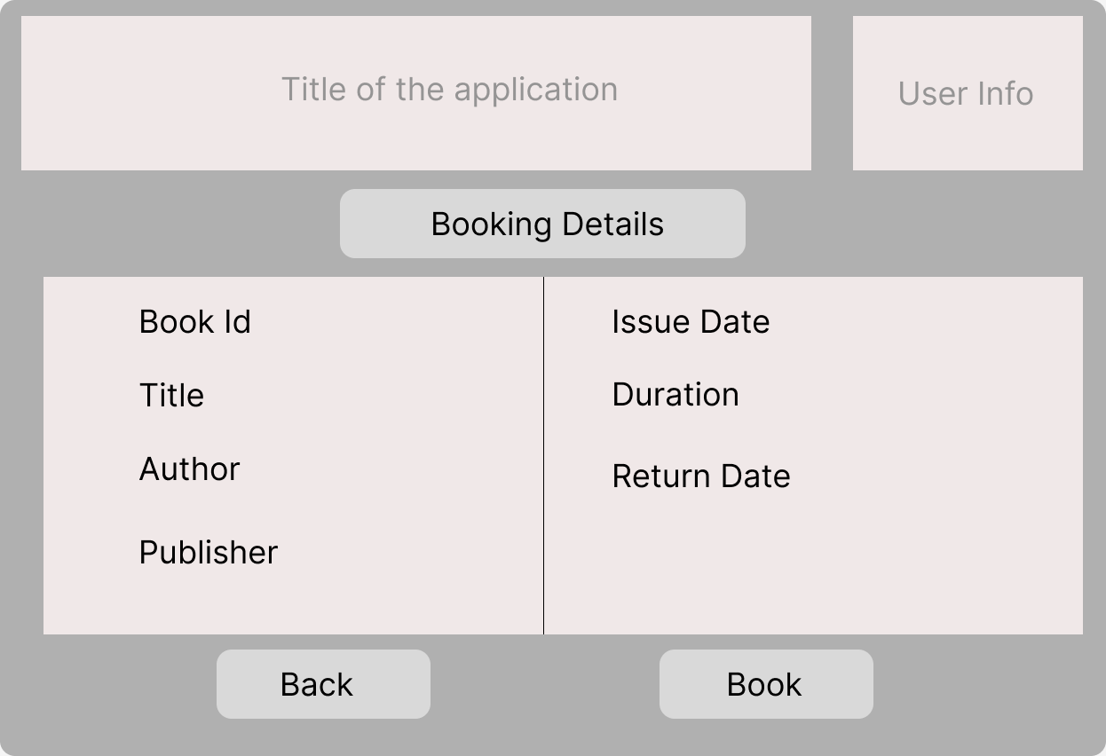
Online Library Management System
Suggest Layout Design
Booking Page

Slide 15
Hands-on

Slide 16


